Slide 1
Global Power platform bootcamp 2025
Organized Globally, held Locally
Integrating Azure AI Search with Copilot Studio
Vinoth Selvam

Slide 2

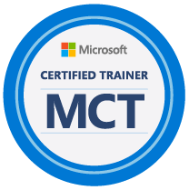


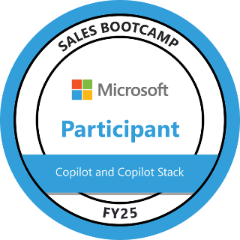
About Me: Vinoth Selvam
12+ years of total experience in IT Industry with major Experience as Microsoft Dynamics 365 CE/CRM Techno-Functional Consultant handling the Functional & Technical aspects in implementation of various Dynamics 365 CE projects across different Industry sectors in Dynamics CE Sales, Service, Field Service and Marketing module.
10+ Years of hands-on Dynamics 365 CE/CRM implementation and Production support experience working on multiple CRM projects across its full life-cycle.
Expertise with Microsoft Power Platform for 5+ years in Power Automate Flow, Power BI, Power Apps.
Recent Experience in Microsoft Copilot and Copilot Studio in building Custom Copilots.
Currently serving as Technical consultant in Avanade, Singapore.

Slide 3

Agenda
About Copilot Studio​
Why Azure AI Search​?
Demo Scenario and Proposed Solution​
Creating a Blob Container and Uploading a File to the Blob​
Creating an Azure OpenAI Resource​
Deploying a Model​
Creating an Azure AI Search Service​
Getting Azure AI Search API Key & Endpoint
Integrating the AI Search with Copilot Studio
Summary and Conclusion

Slide 4
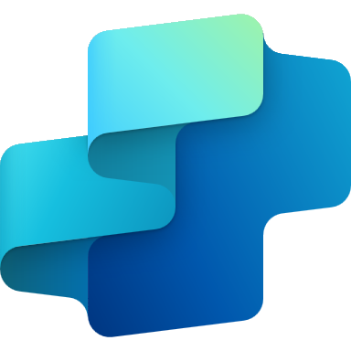
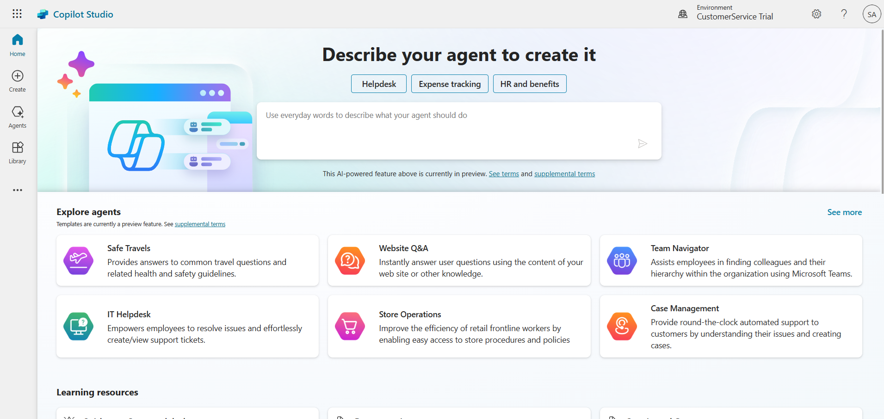
Microsoft Copilot Studio
Copilot Studio is an end-to-end conversational AI platform for extending Microsoft Copilot or building your own copilot Agents with generative AI and large language models
Notes:
Copilot Studio is a powerful tool that allows you to create and customize AI copilots using a low-code platform. It provides a graphical development environment to build copilots using large language models (LLMs) and additional sources of knowledge. This platform is designed to be accessible even to those without extensive technical backgrounds, making it easier for users to create and manage their copilots.

Slide 5

Copilots and Conversational AI
Microsoft 365
Conversational Experiences for M365
Biz Apps & Power Copilots
Conversational Experiences for D365 and Power products
Other Microsoft Copilots
Custom Copilots
Custom copilots and bots for enterprises and third parties
Copilot for Microsoft 365
Custom Enterprise Copilots
Service Copilot
Sales Copilot
Windows Copilot
Microsoft Security Copilot
Copilot for Power Platform
GitHub Copilot
…
Microsoft Copilot Studio Extend and customize 1st party copilots | Build custom Copilots Agents
Bot Framework / SDK
Bot Service Channels
Azure AI Studio
Azure Cognitive Services
Power Platform Connectors
AI Builder

Slide 6
Sample Use Cases
Customer Support Automation – Retrieve FAQs, policies, and troubleshooting guides instantly.
HR & Employee Assistance – Provide employees with HR policies, benefits, and company guidelines.
Non-Profit & Donor Support – Fetch donor program details and event information.
Legal & Compliance – Search legal documents and compliance policies in a chatbot.
Healthcare & Research – Retrieve medical guidelines, clinical research papers, and SOPs.

Slide 7
Why Azure AI Search?
Azure AI Search (formerly Azure Cognitive Search) is a cloud-based search service that enables AI-powered search over structured and unstructured data. It provides features like full-text search, filtering, ranking, semantic search, and vector search using AI models like OpenAI embeddings.
AI-Powered Search : Uses semantic & vector search for relevant answers
Handles Large Data : Searches PDFs, Word, and text documents efficiently
Fast & Scalable : Provides quick responses for enterprise-level use
Seamless Integration : Connects easily with Copilot Studio & Power Automate
Secure & Compliant : Supports role-based access and data privacy
Notes:
Azure AI Search in Copilot Studio enables intelligent search capabilities, retrieving information from structured and unstructured data sources. It allows bots to search, rank, and return precise answers from various documents and knowledge bases. Original Content: Using Azure AI Search Inside Copilot Studio Azure AI Search enables intelligent, AI-powered search capabilities inside Copilot Studio, allowing bots to retrieve relevant information from structured and unstructured data sources. By integrating Azure AI Search, Copilot can search, rank, and return precise answers from documents, FAQs, policies, and other knowledge bases.

Slide 8
Demo Scenario
Organization: A Global Business Consulting Firm
A multinational firm offering strategy, technology, and financial advisory services.
The company has: ✅ Thousands of reports, case studies, and client proposals. ✅ Internal documentation on best practices, compliance, and HR policies. ✅ A large workforce spread across multiple geographies.
Business Challenge
❌ Consultants and employees struggle to find relevant documents and reports. ❌ Knowledge is scattered across SharePoint, OneDrive, and internal databases. ❌ Teams rely heavily on email and manual searches, slowing productivity. ❌ The existing chatbot provides basic responses but lacks intelligent search.

Slide 9
The Solution: Azure AI Search + OpenAI + Copilot Studio
To streamline knowledge retrieval, we can implement Azure AI Search with Copilot Studio, enabling consultants to access relevant information instantly.
Step 1: Centralized Data Storage in Azure Blob
Internal documents (case studies, reports, policies) were uploaded to Azure Blob Storage.
This allowed secure, scalable, and organized data storage.
Step 2: AI-Powered Indexing with Azure AI Search
Azure AI Search was configured to index structured and unstructured data.
The search index included title (document name), content (text extracted from reports and PDFs) and vector_embedding (AI-powered search representation).

Slide 10
The Solution: Azure AI Search + OpenAI + Copilot Studio
Step 3: Implementing OpenAI Embeddings for Semantic Search
OpenAI’s text-embedding-ada-002 model was used to generate vector embeddings.
This enabled contextual and intelligent search instead of just keyword matching.
Step 4: Integrating with Copilot Studio for AI Chatbot
The chatbot in Copilot Studio was configured to fetch relevant answers from indexed knowledge bases.
Step 5: Deployment & User Testing
The enhanced AI-powered chatbot was deployed in Microsoft Teams, SharePoint, and the company’s intranet.
Employees could now ask natural language queries and get instant, relevant responses from reports & policies.

Slide 11
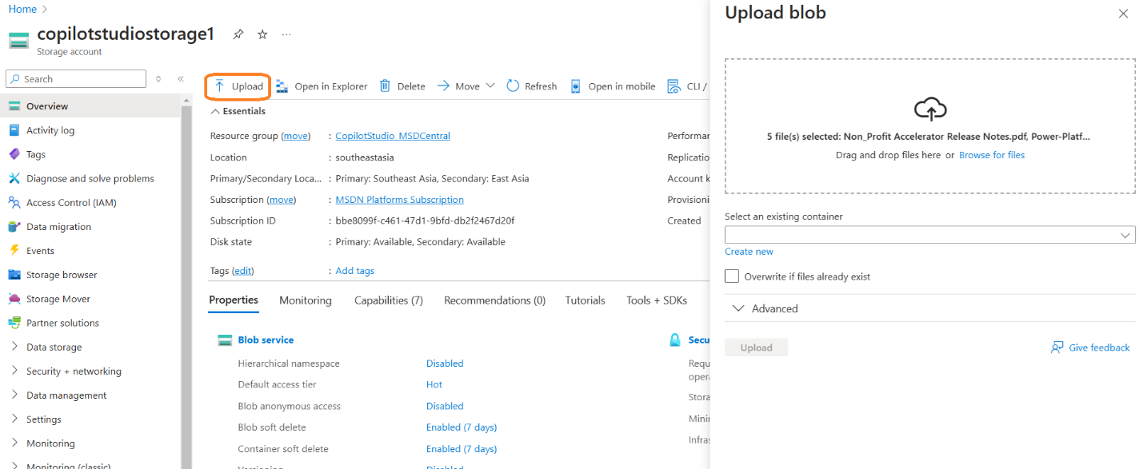
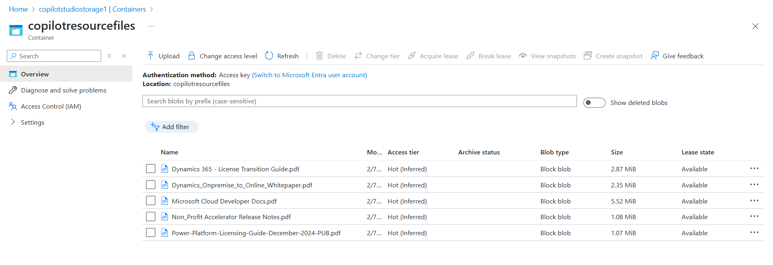
Organizing the Files in Blob
Notes:
To upload a file to the blob, first open the newly created container. Click the upload button, select a file from your local system, and then click upload again to complete the process. Original Content: Step 4: Upload a File to the Blob Open the newly created container. Click Upload. Select a file from your local system. Click Upload.

Slide 12
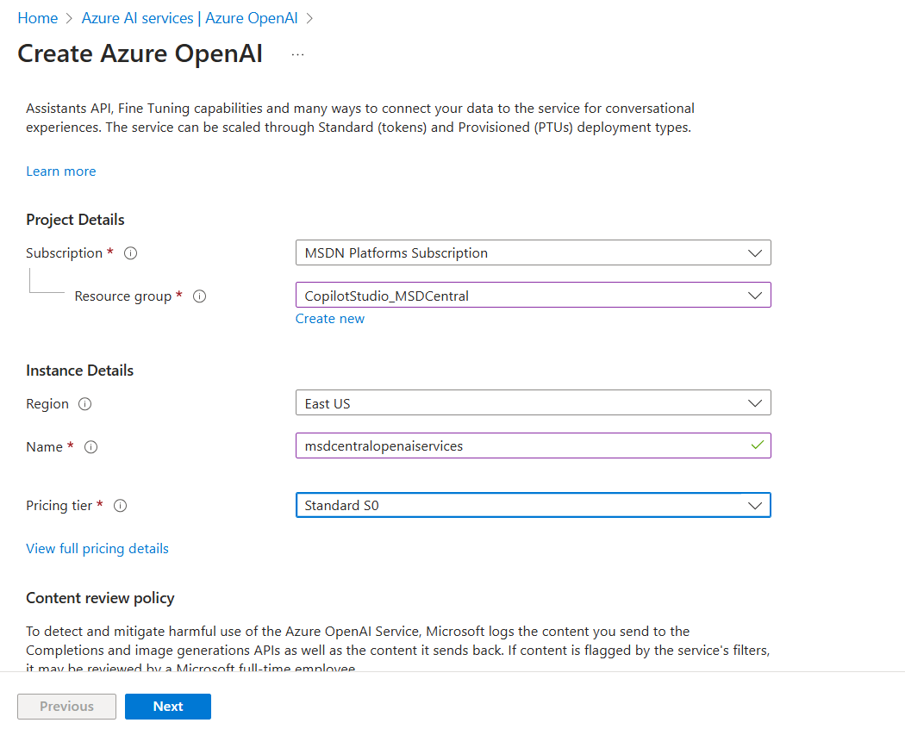
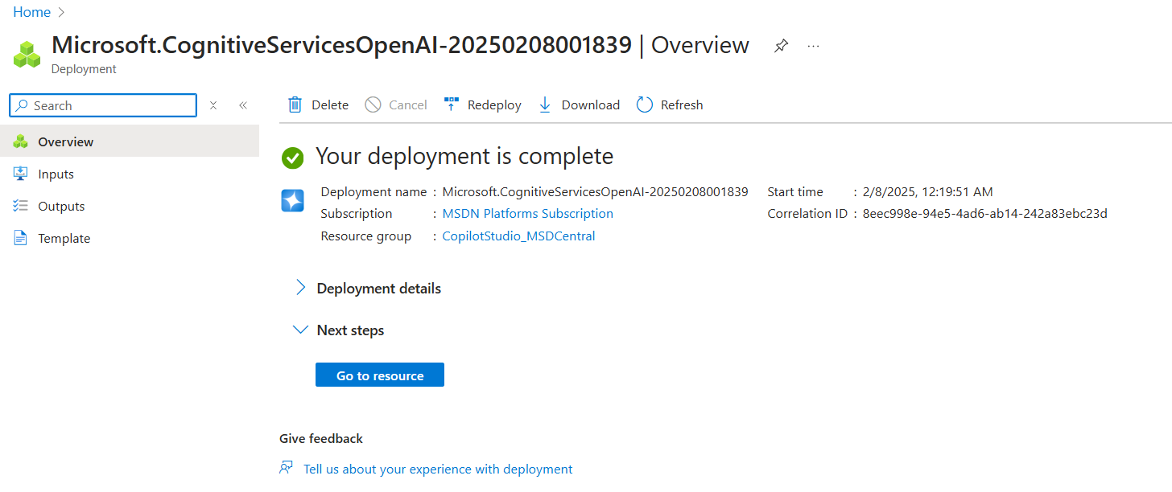
Creating an Azure OpenAI Resource
What is Azure OpenAI Service?
Azure OpenAI Service provides access to OpenAI’s powerful language models (GPT-4, GPT-3.5, Codex, DALL·E, etc.) via Azure’s cloud infrastructure. It enables businesses to integrate AI-powered capabilities like text generation, summarization, chatbots, and more with enterprise security and compliance.
Notes:
Azure OpenAI Service allows access to powerful language models via Azure’s cloud. To create a resource, search for 'Azure OpenAI', select the service, and click + Create. Choose your subscription, resource group, region, name, and pricing tier. Configure network security, review, and submit. Finally, proceed using Azure AI Foundry portal. Original Content: Step 5: Create an Azure OpenAI Resource What is Azure OpenAI Service? Azure OpenAI Service provides access to OpenAI’s powerful language models (GPT-4, GPT-3.5, Codex, DALL·E, etc.) via Azure’s cloud infrastructure. It enables businesses to integrate AI-powered capabilities like text generation, summarization, chatbots, and more with enterprise security and compliance. Search for "Azure OpenAI" in the search bar and select Azure OpenAI Service. Click + Create to start a new deployment. Select a Subscription and Resource Group (or create a new one). Region: Choose a supported region (e.g., East US, West Europe). Name: Enter a unique name for the OpenAI instance. Pricing Tier: Choose Standard. Next in the Network Tab, you can choose to configure the network security for the Azure AI resource. Click Review + Submit, then Create. Once the deployment is completed, we proceed to next step using Azure AI Foundry portal.

Slide 13
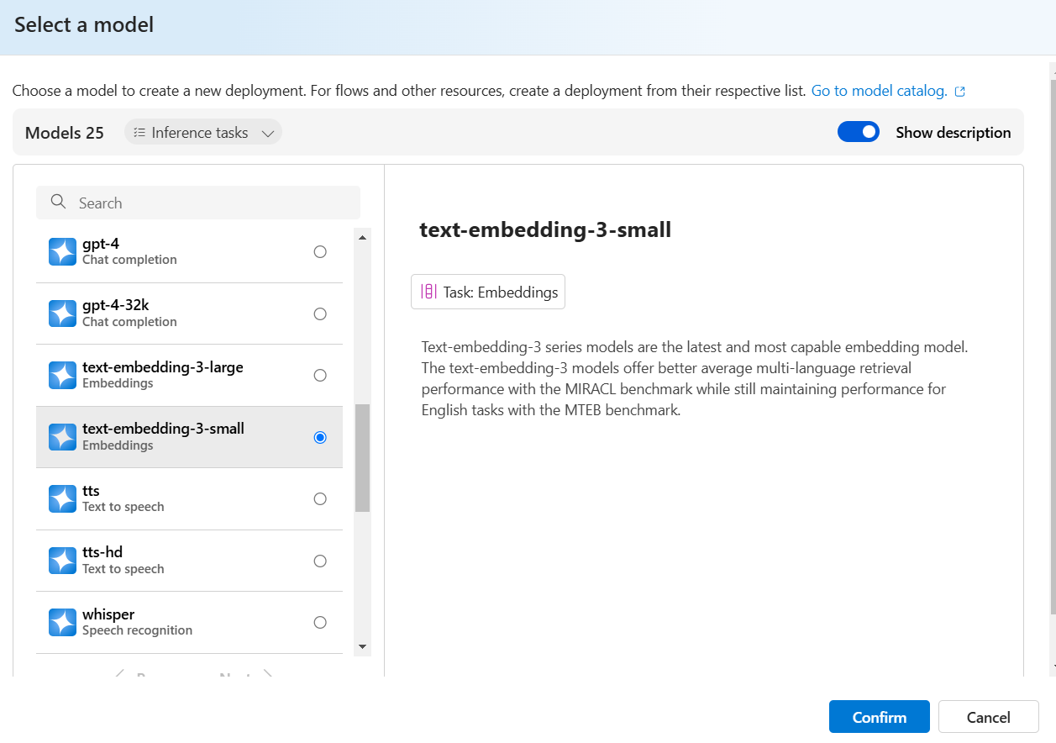
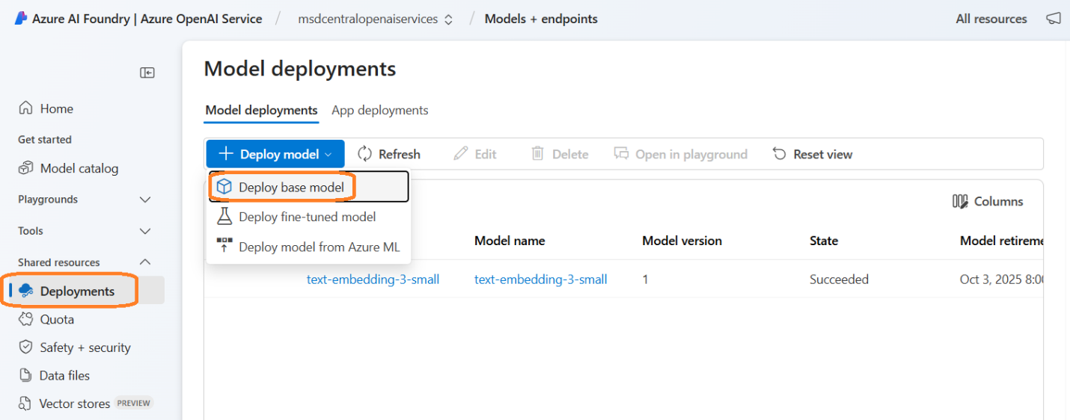
Deploy a Model in Azure AI Foundry Portal
You can choose any of the below:
GPT models (for chat, content generation) → For eg: gpt-4, gpt-3.5-turbo.
Embeddings models (for knowledge retrieval) → Select text-embedding-3-small.

Slide 14
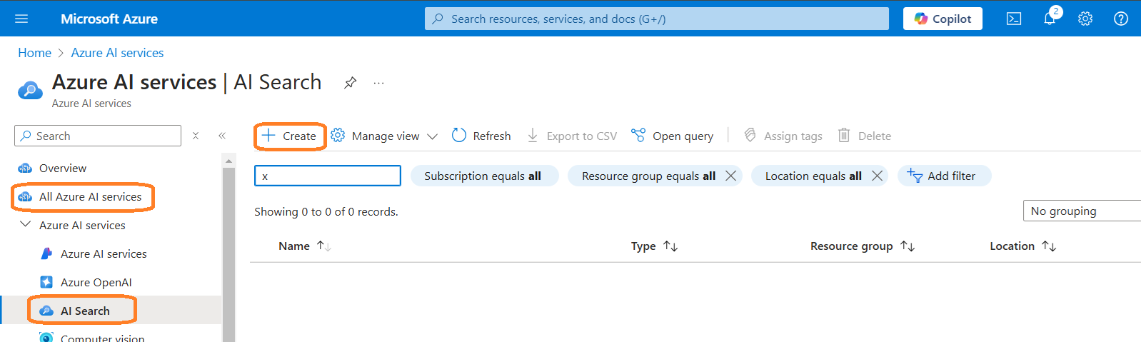
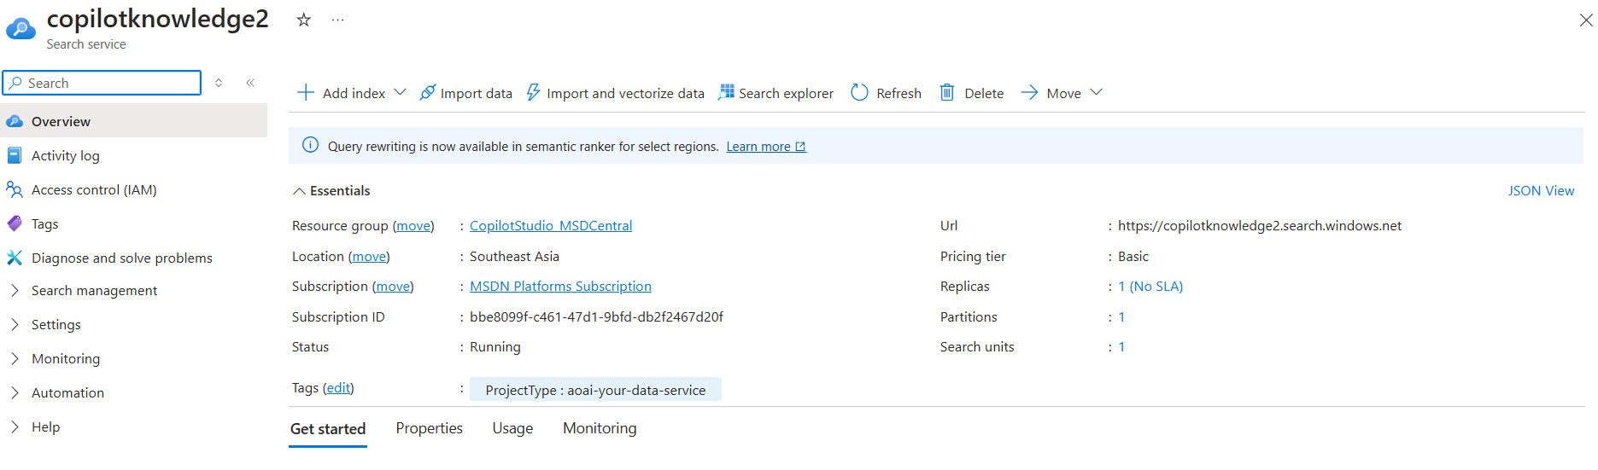
Create an Azure AI Search Service
Click + Create to create a new search service.
Subscription: Choose your subscription.
Resource Group: Select an existing one or create a new one.
Service Name: Provide a unique name (e.g., mysearchservice).
Region: Choose a supported region (e.g., East US).
Pricing Tier: Select Basic (or higher for AI-powered features).

Slide 15
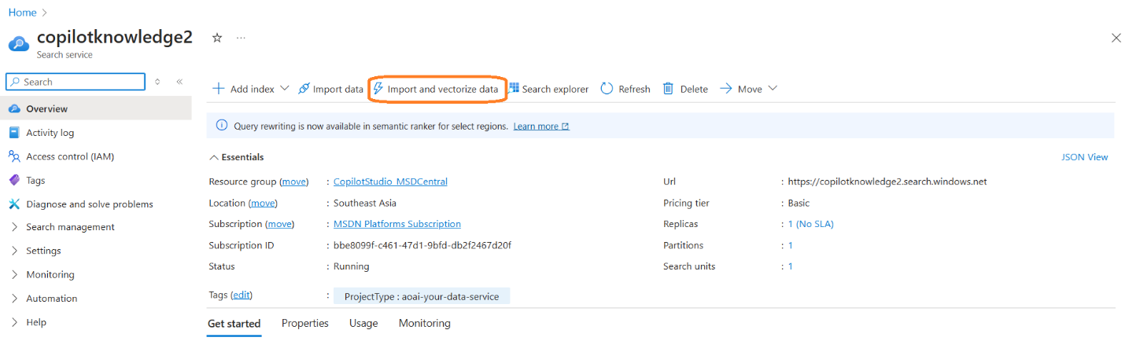
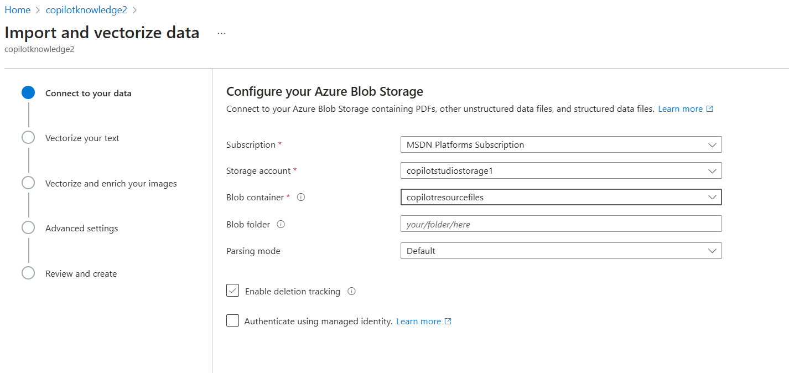
Import and Vectorize
In the Search Service, click on “Import and Vectorize data”.

Slide 16
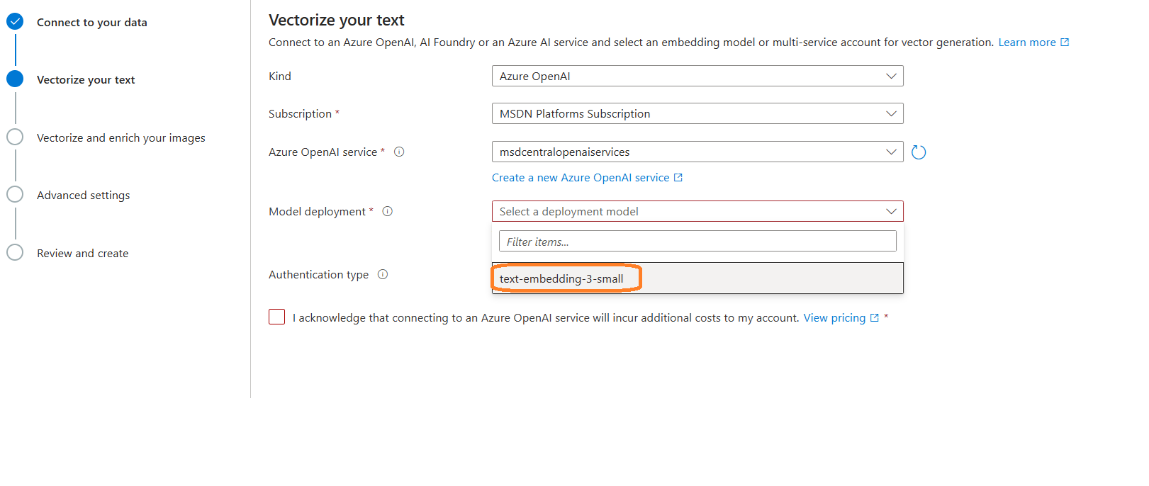
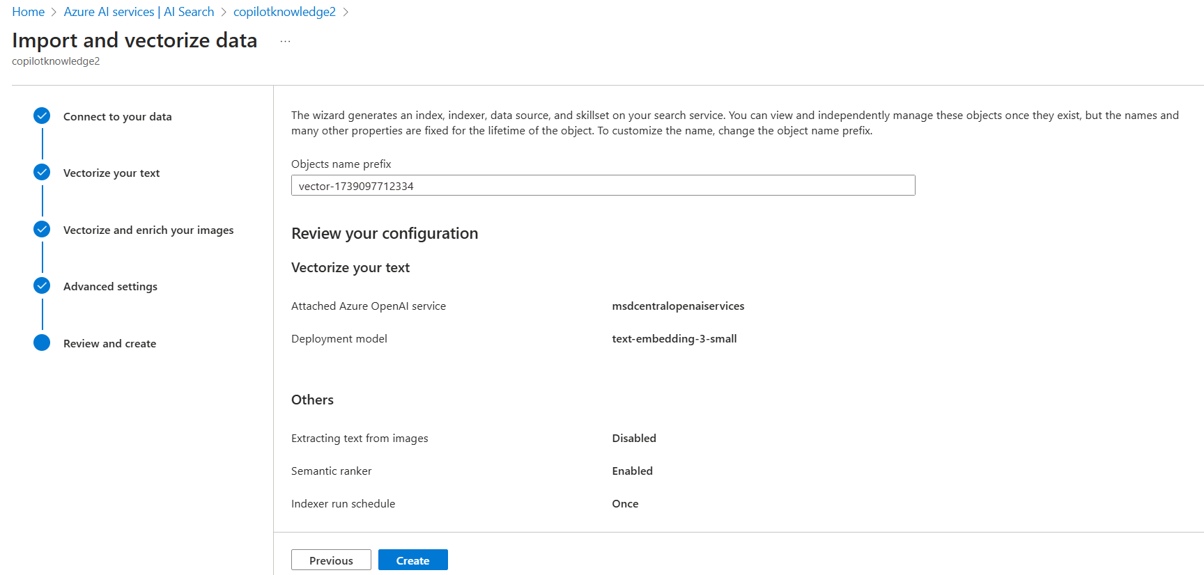
Import and Vectorize

Slide 17
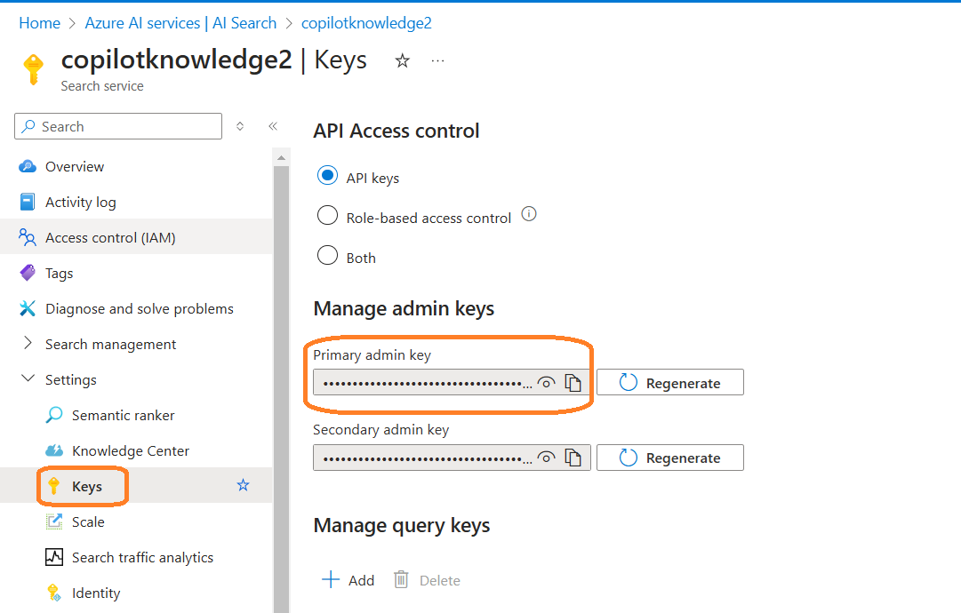
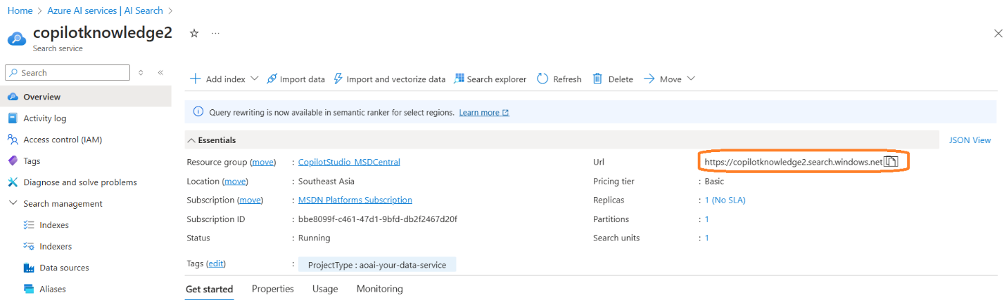
Get the Azure AI Search API Key & Endpoint
Open Azure AI Search in Azure Portal.
Navigate to Settings and Keys.
Get the Primary Admin Key.
Get the URL from Overview tab.

Slide 18
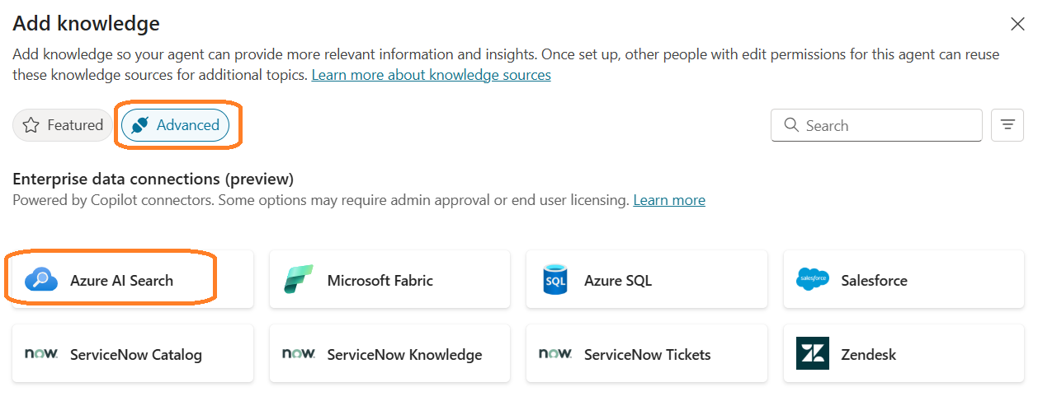
Integrating Azure AI Search with Copilot Studio
Navigate to Copilot Studio -> Create a new Agent or use existing Agents
Enable Generative AI option
Navigate to Settings -> Generative AI
Enable Generative (preview) option
Disable Copilot's general Knowledge to ensure responses come from specified knowledge
Add Knowledge -> Select Advanced Tab -> Select Azure AI Search
Notes:
To integrate Azure AI Search in Copilot Studio, navigate to Copilot Studio, enable Generative AI, add knowledge from Azure AI Search, create a new connection, choose vector index, and test Copilot using the knowledge source. Original Content: Step 8: Integrate Azure AI Search inside Copilot Studio Azure AI Search can be integrated into Microsoft Copilot Studio to enable AI-powered knowledge retrieval. This is useful for searching documents, FAQs, policies, or any indexed data in Azure AI Search. Navigate to the Copilot Studio (https://copilotstudio.microsoft.com/). You can create a new Agent or even use the existing Agents. Navigate to the Settings -> Generative AI option. Enable the Generative (preview) option which uses the Gen AI to respond with the nest combination of Actions, topics and Knowledge. In the Knowledge source, we can disable the Copilot to use its own general Knowledge. This is just to make sure the response come through the knowledge that we specify. Click on ‘+ Add Knowledge’ and select the Advanced Tab. We can see the “Azure AI Search” option. Selecting the option will open the below pop-up. Next we need to create a new Connection to Azure AI search. Click on Create. Choose the Authentication type as Access key. We have already extracted the Endpoint URL and Search Admin key from the Azure AI Search service. Fill up the required details and click on Create button. Next, we will need to choose the vector index. We can use the same that we created during the Azure Search. Once one, the Knowledge is successfully added inside the Copilot. Now its time to test our copilot. We don’t even need to create any new topics at this point, since copilot has the ability to use the knowledge source based on any unknown intent also. Try to give a Prompt based on the data that is present in our Azure Search. To verify, I have enabled the Activity Map to find out the knowledge source how the response is received. Copilot able to provide the response as expected. We can also see the different vector references. Click on the vector to see the source from where the data is retrieved.

Slide 19
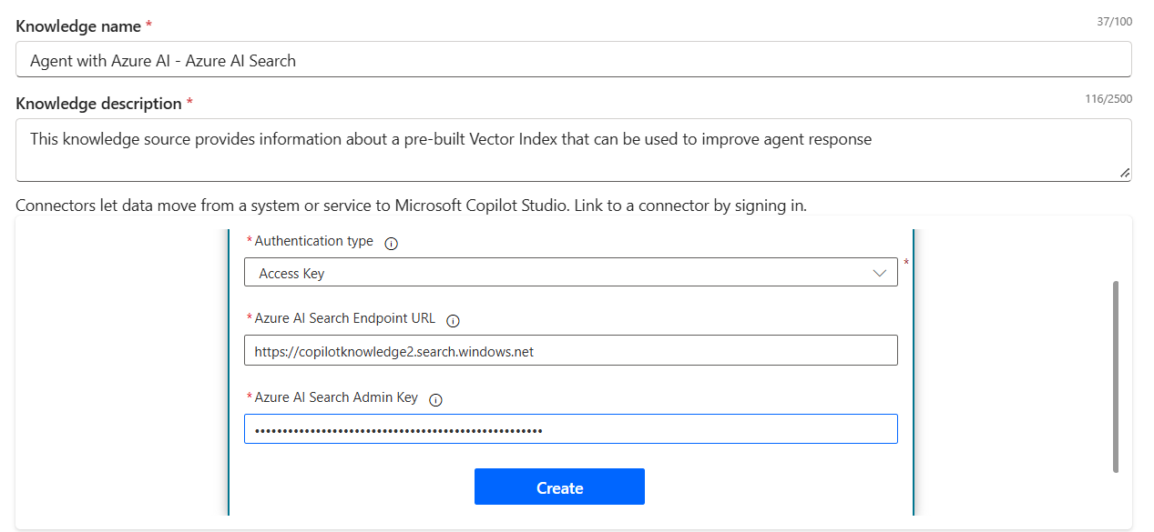
Integrating Azure AI Search with Copilot Studio
Click on Create.
Choose the Authentication type as Access key.
We have already extracted the Endpoint URL and Search Admin key from the Azure AI Search service.

Slide 20
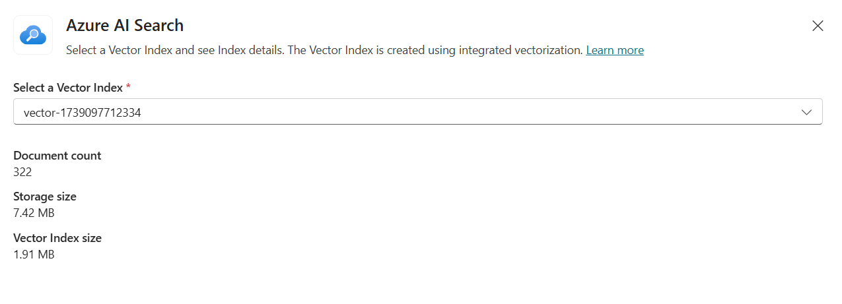
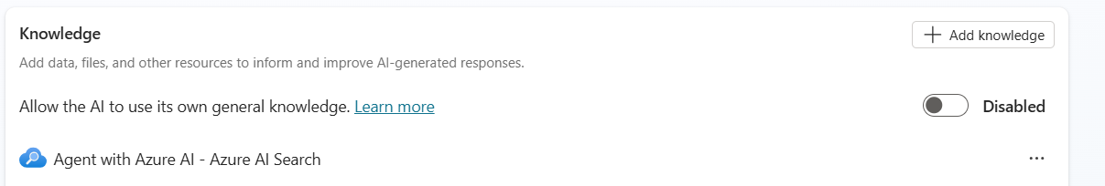
Integrating Azure AI Search with Copilot Studio
We will need to choose the vector index.
We can use the same that we created during the Azure Search.

Slide 21
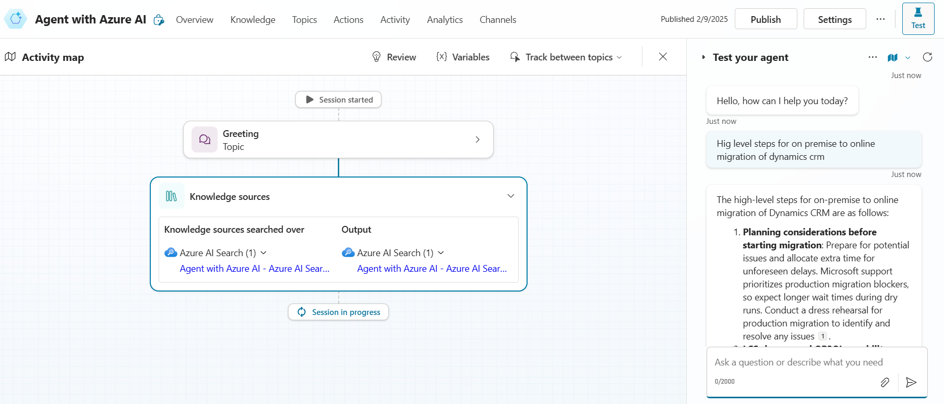
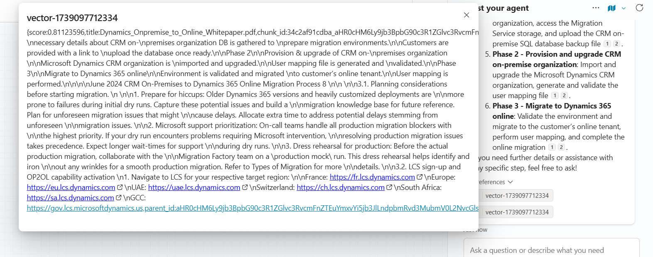
Testing Copilot
Notes:
We tested Copilot's capabilities using Azure AI Search. It handles unknown intents, uses knowledge sources, and verifies responses via Activity Map. Copilot provided expected responses, showcasing its efficiency in intelligent document and data retrieval. Original Content: Now its time to test our copilot. We don’t even need to create any new topics at this point, since copilot has the ability to use the knowledge source based on any unknown intent also. Try to give a Prompt based on the data that is present in our Azure Search. To verify, I have enabled the Activity Map to find out the knowledge source how the response is received. Copilot able to provide the response as expected. Azure AI Search – AI-powered semantic and vector search for intelligent document and data retrieval.

Slide 22
Summary
Feature | Direct File Upload in Copilot Studio | Azure Blob + AI Search in Copilot Studio
Setup Complexity | ✅ Simple – Directly upload files into Copilot Studio. | ❌ More complex – Requires setting up Azure Blob Storage & AI Search.
Search Capabilities | ❌ Basic keyword-based search. Takes time with long, complex queries. | ✅ Advanced semantic & vector search for accurate, context-aware retrieval.
Scalability | ❌ Limited – Suitable for small knowledge bases only. | ✅ Highly scalable – Can handle large datasets efficiently.
Performance & Speed | ✅ Fast for small data sets but slows down with large volumes. | ✅ Optimized for large-scale searches using AI indexing.
Response Accuracy | ❌ Low – Keyword-based search often returns irrelevant results. | ✅ High – AI-powered search ensures relevant, ranked responses.
Automation & AI Processing | ❌ No AI-based enrichment or processing. | ✅ Supports AI enrichment (OCR, entity recognition, embeddings, etc.).
Maintenance & Updates | ✅ Low maintenance – Managed within Copilot Studio. | ❌ Requires maintenance of Azure resources & AI search indexes.
Adding Knowledge Source | ❌ Addition of Knowledge source can be done only by Copilot Author. Indexing has to be done for frequent Knowledge file updates. | ✅ Addition of Knowledge source can be done by anyone with proper access to the blog storage, without disturbing the copilot studio setup. Indexing and Vectorization can be scheduled to happen automatically.
Notes:
We tested Copilot's capabilities using Azure AI Search. It handles unknown intents, uses knowledge sources, and verifies responses via Activity Map. Copilot provided expected responses, showcasing its efficiency in intelligent document and data retrieval. Original Content: Now its time to test our copilot. We don’t even need to create any new topics at this point, since copilot has the ability to use the knowledge source based on any unknown intent also. Try to give a Prompt based on the data that is present in our Azure Search. To verify, I have enabled the Activity Map to find out the knowledge source how the response is received. Copilot able to provide the response as expected. Azure AI Search – AI-powered semantic and vector search for intelligent document and data retrieval.

Slide 23
Any Questions?

Slide 24
Resources
https://learn.microsoft.com/en-us/microsoft-copilot-studio/knowledge-graph-connections
https://www.microsoft.com/en-us/microsoft-copilot/blog/copilot-studio/copilot-studio-is-enhancing-its-platform-with-knowledge-improvements-azure-ai-integration-and-more/
https://learn.microsoft.com/en-us/power-platform/release-plan/2024wave2/microsoft-copilot-studio/azure-ai-search-index-as-knowledge-source
https://learn.microsoft.com/en-us/microsoft-copilot-studio/nlu-generative-answers-azure-openai
https://msdcentral.site/copilot-studio-sample-use-case-use-files-from-azure-blob-as-knowledge-to-copilot-agents-using-azure-ai-search/

Slide 25
Thank you
Contact Information WhatsApp : (+65) 8872 9718
Website/Blog : https://msdcentral.site/ Email : vinoth_2222@yahoo.com
LinkedIn : www.linkedin.com/in/vinoths2202

